Slide 1
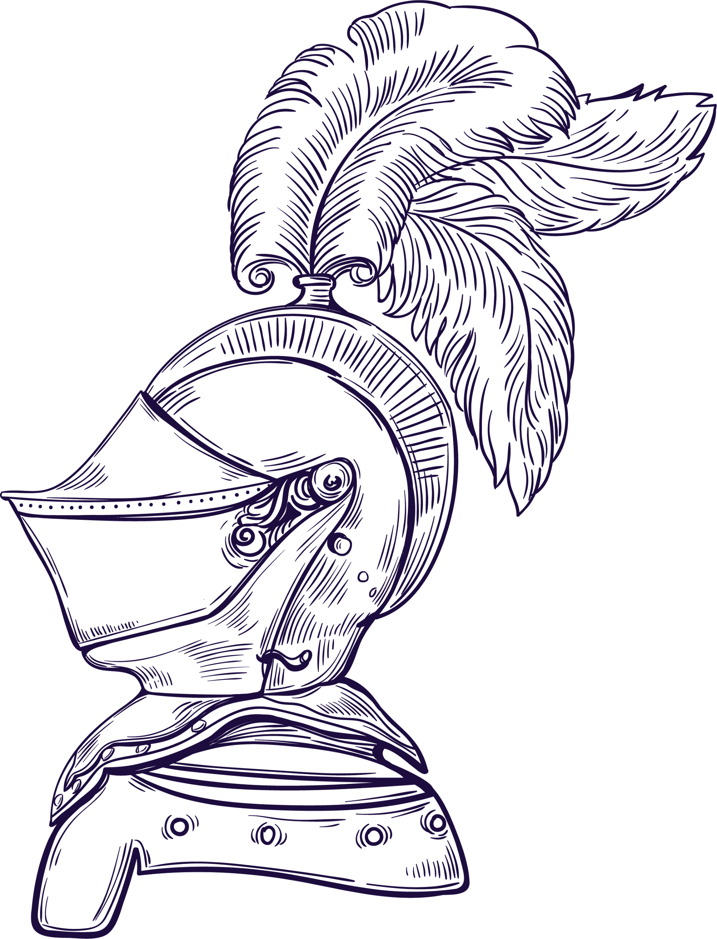
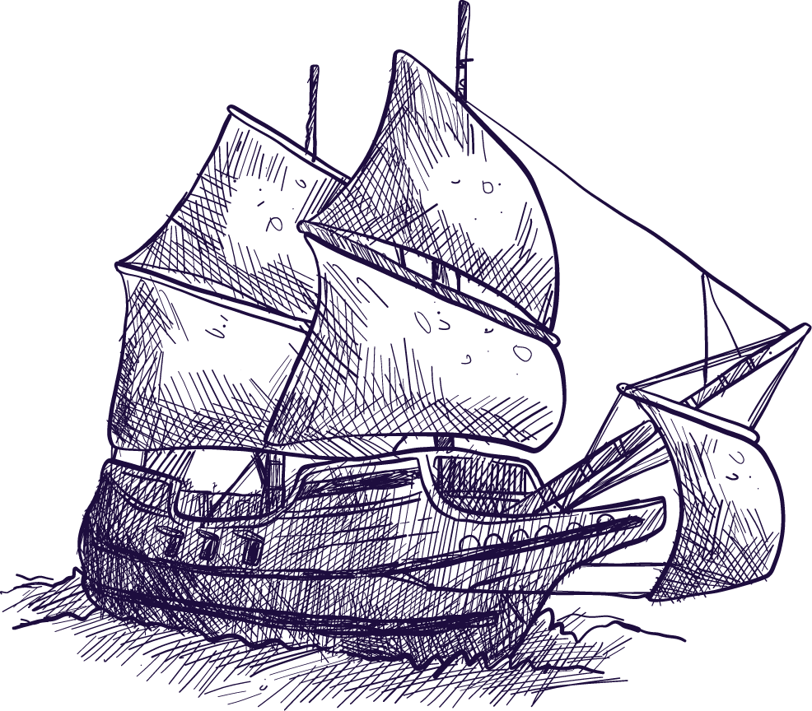
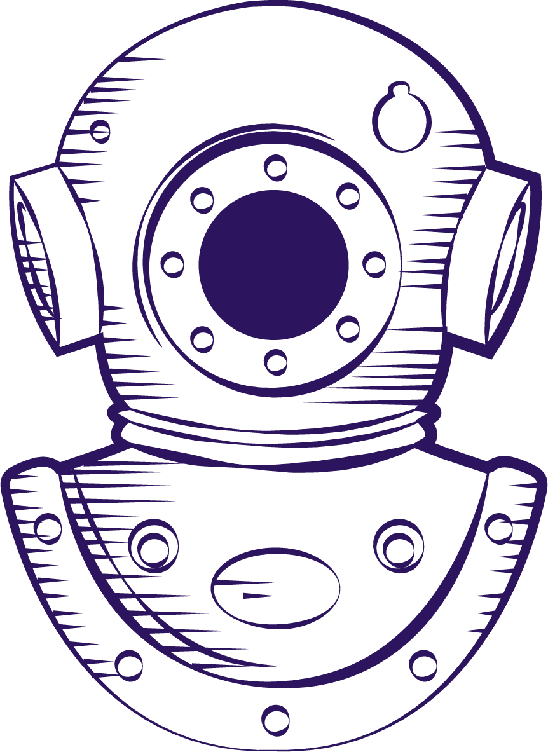
Introduction to
Audiology
The Profession

Slide 2
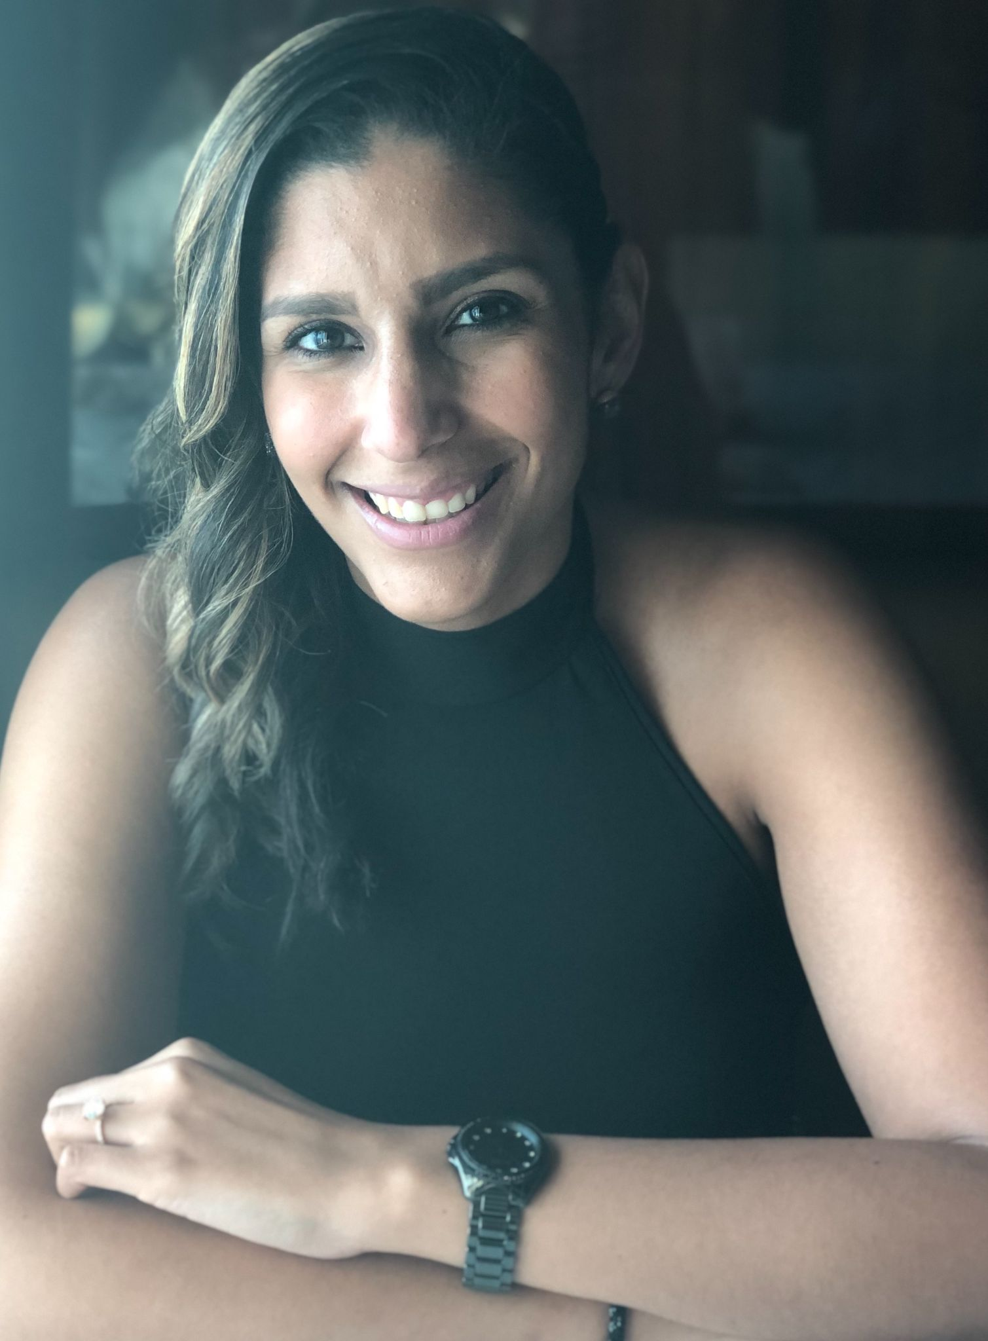
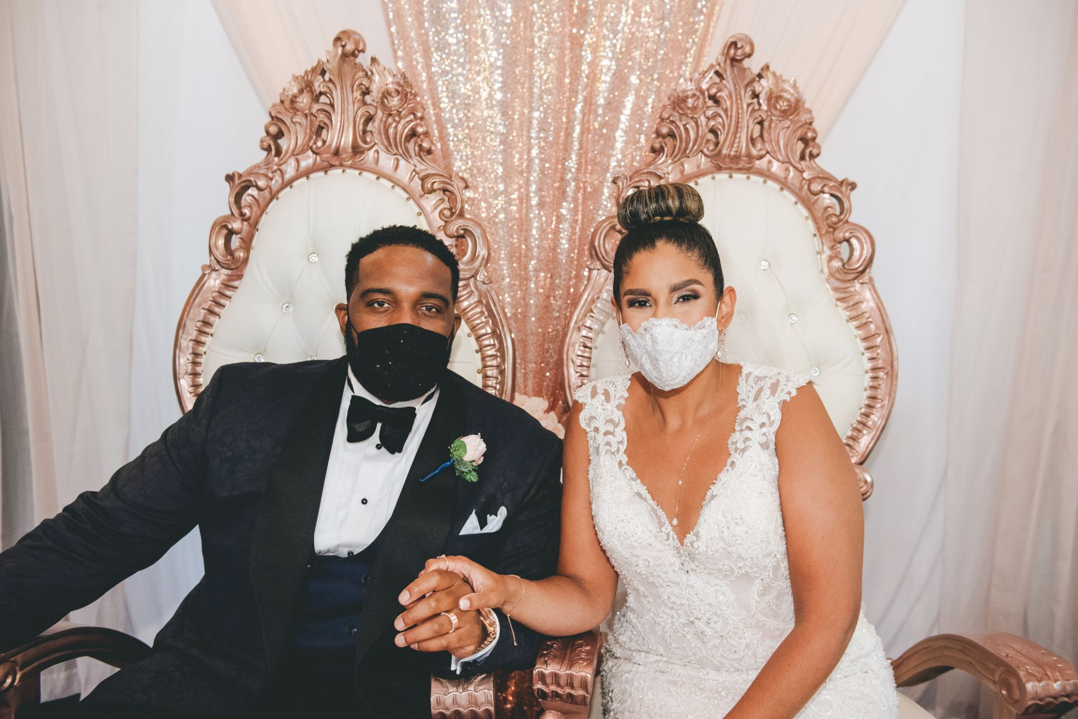
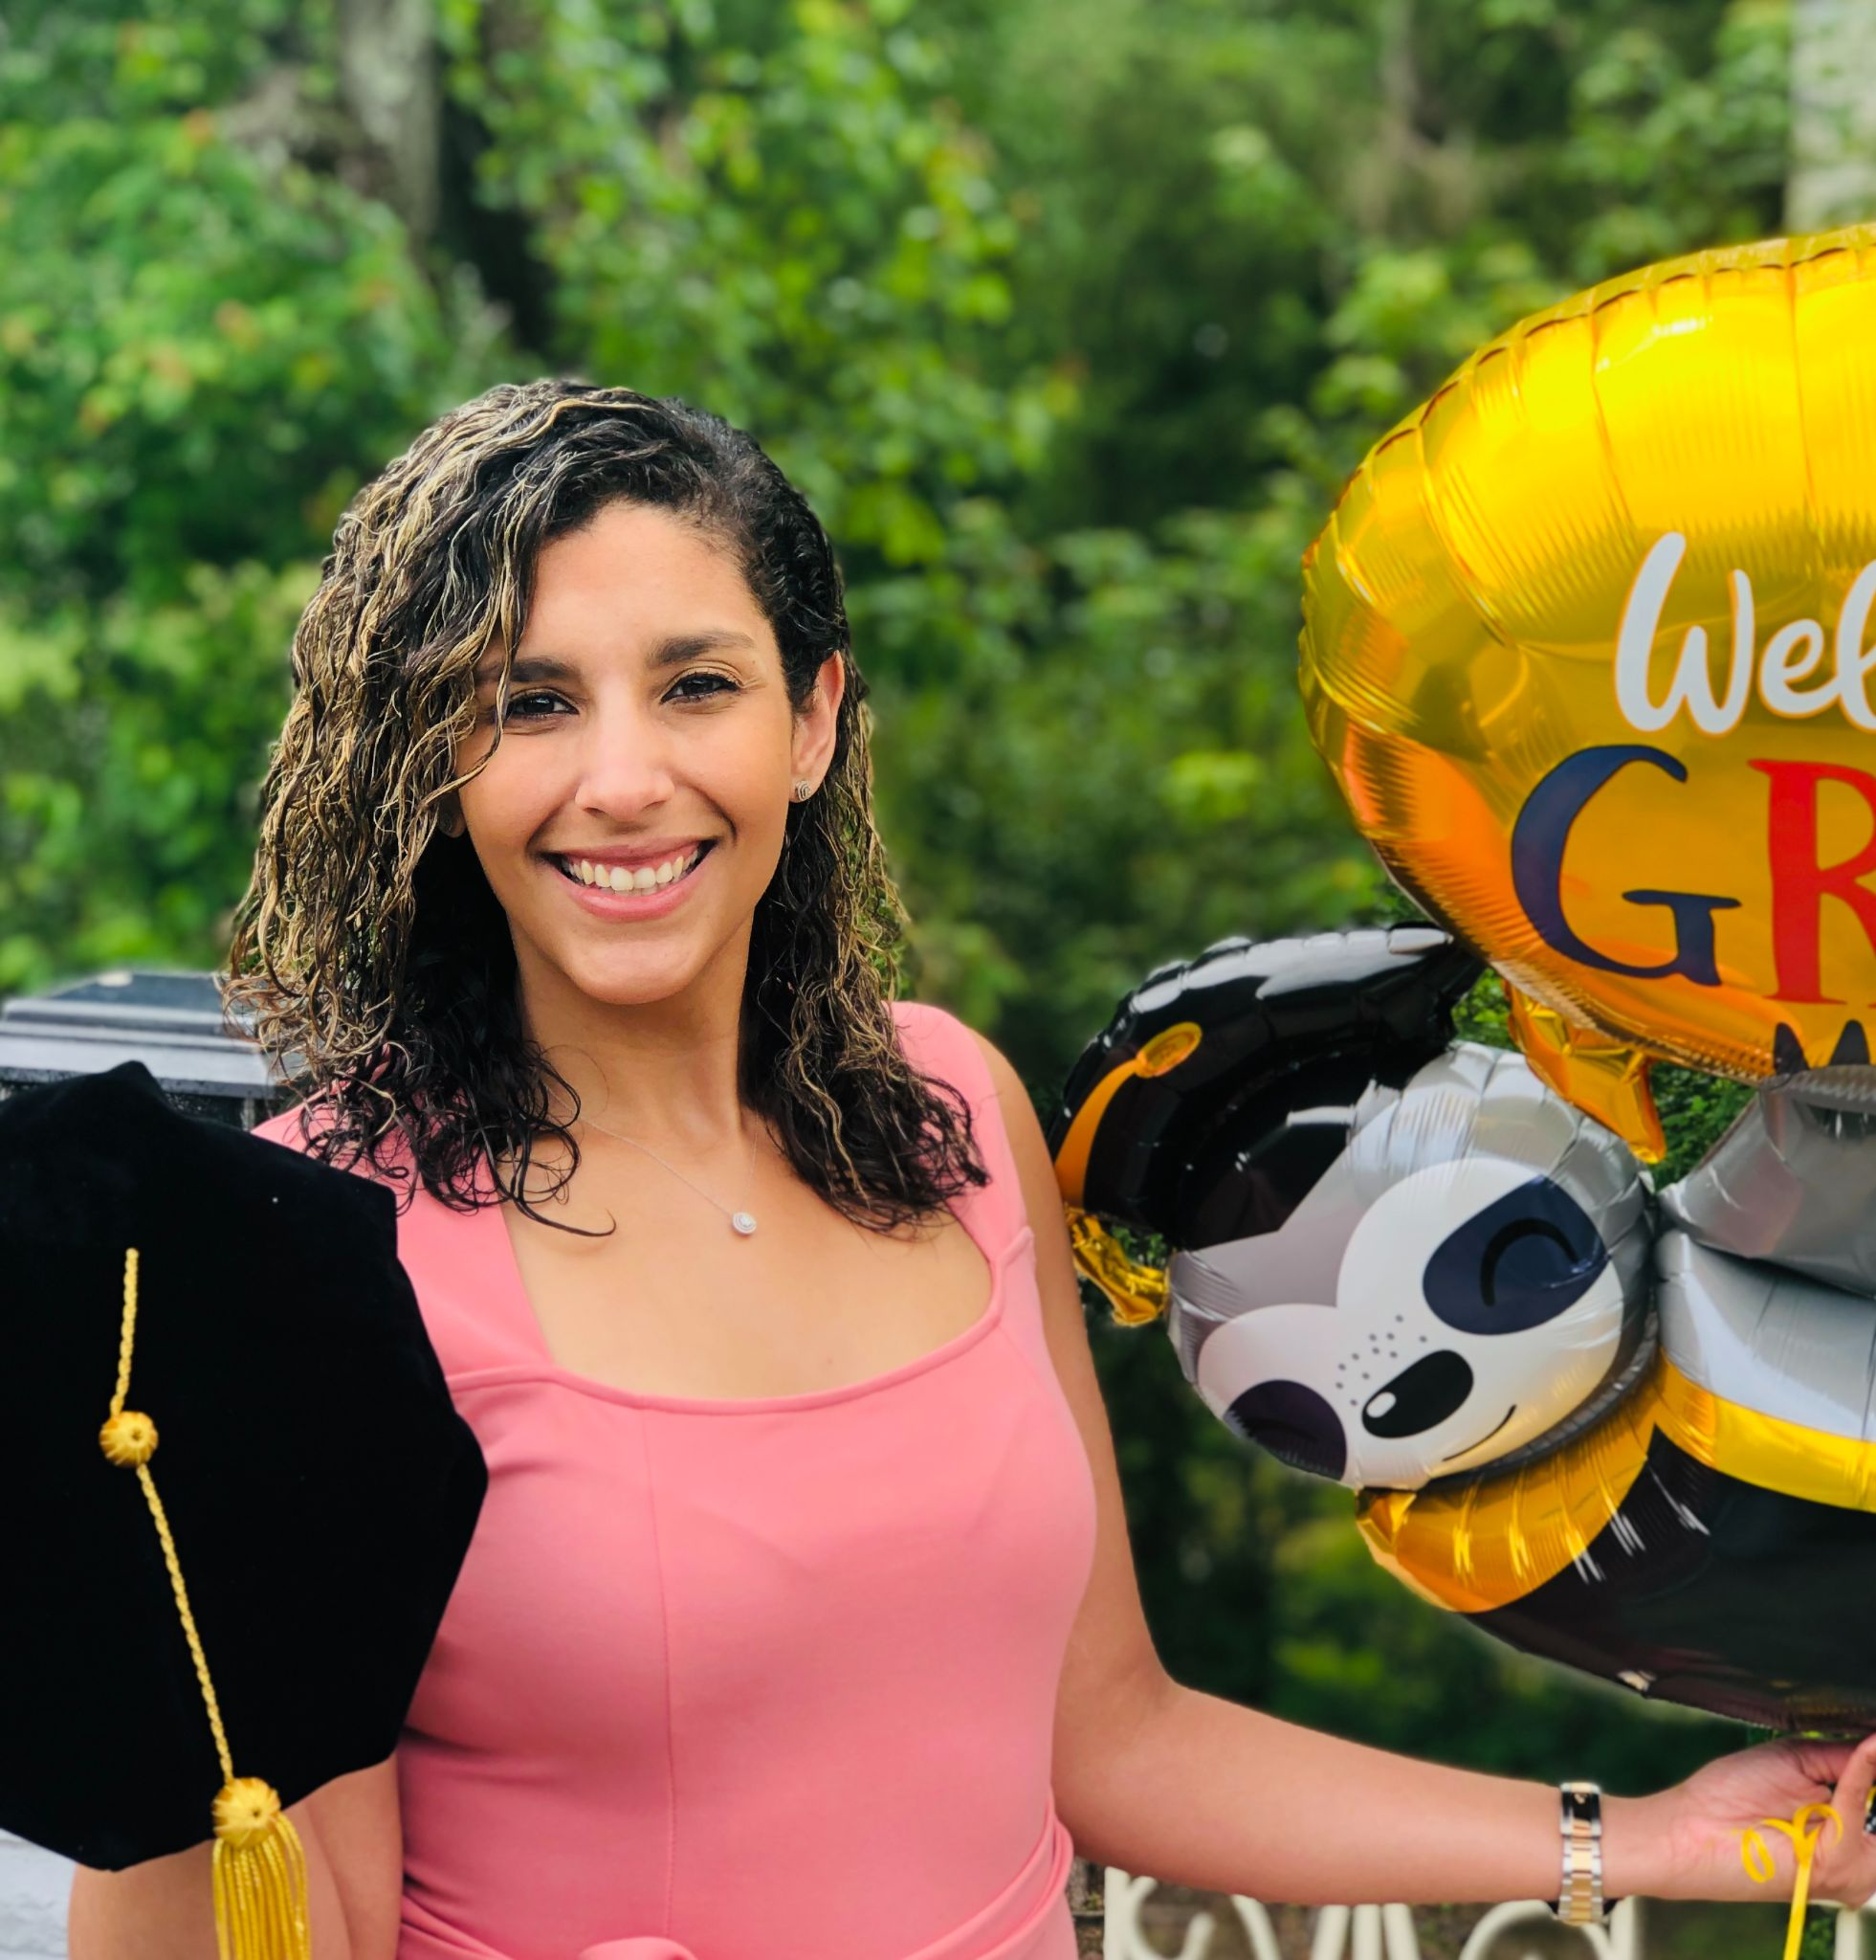
Meet Your Professor
Dr. Jade Igbokwe (ee-bo-kway)
[Dr. Jade/Dr. I/Dr. Igbokwe/Professor]
Graduated from CUNY Grad Center Audiology program
Private practice owner
Married last September!
New baby!

Slide 3
01
03
Scope of Practice
Patient Populations
02
Audiology Settings
04
Important things to know for this course

Slide 4
AUDIOLOGY
The discipline involved in the prevention, identification and evaluation of hearing disorders, the selection and evaluation of hearing aids, and the habilitation/rehabilitation of individuals with hearing loss and balance disorders
Rehabilitation
To improve a skill you have lost
Habilitation
Gaining a skill or function that you have never had
(ASHA, 2018)
Notes:
American Speech‑Language‑Hearing Association. (2018). Scope of practice in audiology [Scope of Practice]. Available from www.asha.org/policy/

Slide 5
Speech + Audiology
HOW DO WE COMMUNICATE? (ASHA, 2021a and b)
Language is acquired naturally through repeated exposure to language early in life
Through frequent exposures, a child learns the pragmatics, or the rules of the language that govern the order of such sound sequences in meaningful phrases or sentences (syntax)
Communication is an active process where information and ideas are shared amongst 2 or more people
It requires both expression and reception
A problem on the expressive or receptive end of communication will cause a break in the chain
Some of the rules we follow:
Taking turns when you talk.
Letting others know the topic when you start talking.
Staying on topic.
Trying another way of saying what you mean when someone did not understand you.
Using gestures and body language, like pointing or shrugging.
Knowing how close to stand to someone when talking.
Using facial expressions and eye contact.
Notes:
https://www.asha.org/njc/definition-of-communication-and-appropriate-targets/
https://www.asha.org/public/speech/development/social-communication/

Slide 6
Breaks in Communication
Degraded signal - either the speaker or the environment have caused the signal to be poor
Hearing impairment will directly affect the quality of signal received by the listener
Cognitive or linguistic deficits can either degrade the message sent or the message received
What can cause a break in communication?

Slide 7
1943
1946
1964
Audiology wasn’t a profession before the 1940s!
CC Bunch created the first audiometer, measuring air conduction thresholds for an ENT in Iowa
Introduction of speech testing to evaluate efficacy of hearing aids on users
Middle ear assessment using immittance is introduced!
(Jerger, 2019)
Notes:
The field is relatively young. It hasn’t even been around 100 years!
In the 1940s young men and women returning from WWII with NIHL needed help.
One of the most important aspects of Audiology, besides better hearing, is the psychosocial impact of hearing loss including social isolation and depression. {https://hsl.lib.unc.edu/speechandhearing/professionshistory}
https://www.hearingreview.com/practice-building/practice-management/continuing-education/ten-highlights-history-audiology#:~:text=The%20modern%20era%20of%20audiology,the%20family%20of%20healthcare%20professions.

Slide 8
Scope of Practice - Audiology (ASHA, 2018)
Audiologists who are:
Educated (doctorate level degree)*
Typically a 4 year degree, some are 3, with built in clinical experiences to prepare the future clinician for practice.
Trained (internship/externship experiences during education)
Licensed (through the state)
Certified (ASHA CCC’s / AAA fellow)
Provide the following services:
Hearing and balance assessment
Non-medical treatment
(Re)habilitation
Primary focuses for hearing and balance care include:
Prevention
Identification
Diagnosis
Notes:
The first AuD program began in 1994 at Baylor University.
There are still some audiologists that maintain the Master’s Degree which was the previous highest level of degree for audiology.
These clinicians have been “grandfathered” in, many with the option to “upgrade” their degree.

Slide 9
Prevention
Monitoring hearing levels of employees at a factory, for example
Creating a hearing conservation program for employees
Regular monitoring
Instruction and monitoring of use of hearing protection
Insert foam earplugs, ear muffs, a combination, or electrical/molded hearing protection
Education on the dangers of noise exposure on hearing
Hearing Conservation

Slide 10
Prevention
Important things to remember from the video:
What affects noise exposure → hearing loss?
Decibels - level of noise
Moderate/safe = 50-60dB
Unsafe = 85-115dB -- depending on time!
Duration - how long are you exposed to the noise level?
8 hrs at 85dB then time halves with every rise in 3 dB!!!
Distance - the further you are from the noise, the safer it is!
Decibel level decreases by 6dB with every doubling of distance!

Slide 11
Identification
Screening programs
School-based screenings
Geriatric settings
Diagnostic testing using audiometry (subjective) or advanced diagnostic tests
Can include objective tests of hearing - where the patient is not required to respond
Non-medical diagnosis
Evaluation of functional disability - this can use questionnaires or in situ speech (in noise) testing to determine how the patient does in a real world situation.
Notes:
What’s an example of objective v. subjective auditory testing?

Slide 12
Rehabilitation
Counseling / Education about their hearing and what it means with day to day listening abilities
Auditory training - teaching the patient how to become a better listener and how to use visual cues to improve the message
Hearing devices - based on patient’s hearing levels, using amplification to improve the signal
Creating a better listening environment
For pediatrics (in school) - preferential seating, use of FM system, reduce reverberation
For adults (in a restaurant, e.g.) - sit near a wall, good lighting, in a booth vs. a table, use FM system

Slide 13
Where do Audiologists Work?
01
02
03
04
Hospital/Clinical
Private Practice
Educational
Industrial Settings
Inpatient
Outpatient
Cancer patients receiving ototoxic meds.
Diagnostic testing for all populations
Aural rehabilitation using hearing aids and other counseling
School based audiologists
Testing pediatrics
Monitoring listening conditions and hearing aids for students with HI
Hearing conservation at workplaces with risk of noise exposure
Monitor hearing
Instruct on use of hearing protection

Slide 14
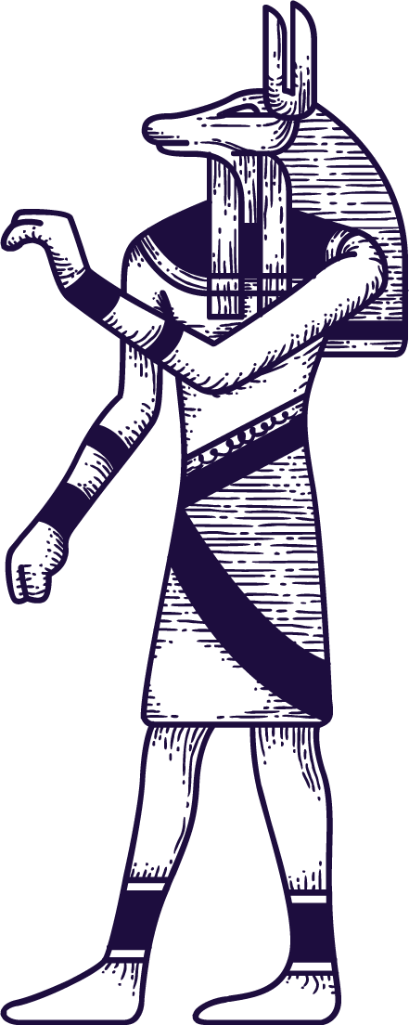
PATIENT POPULATIONS
PEDIATRICS
From birth - 18 years old
Can include objective and subjective testing methods
Test hearing & processing
Can also include balance
ADULT / GERIATRIC
18-100+ years old
Mostly subjective hearing assessments
Hearing and balance evaluations
Effects of cognition

Slide 15
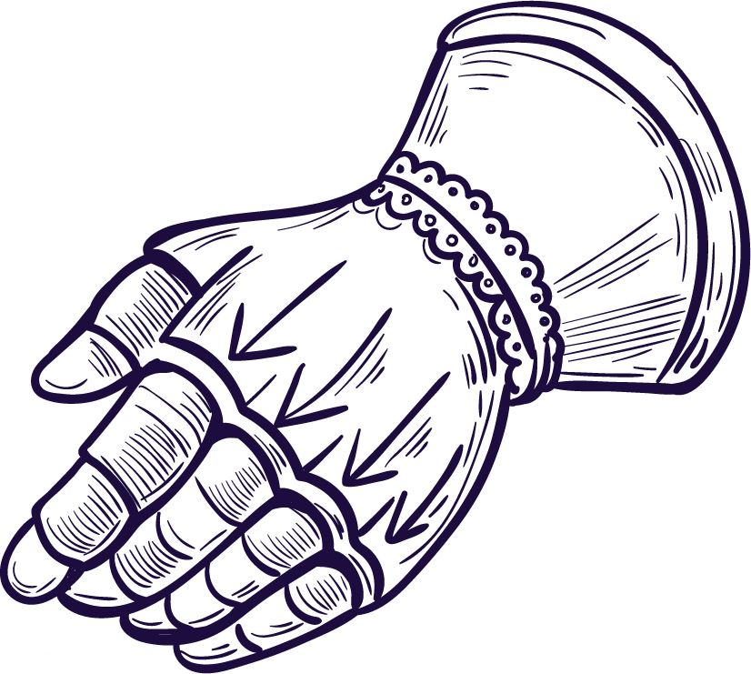
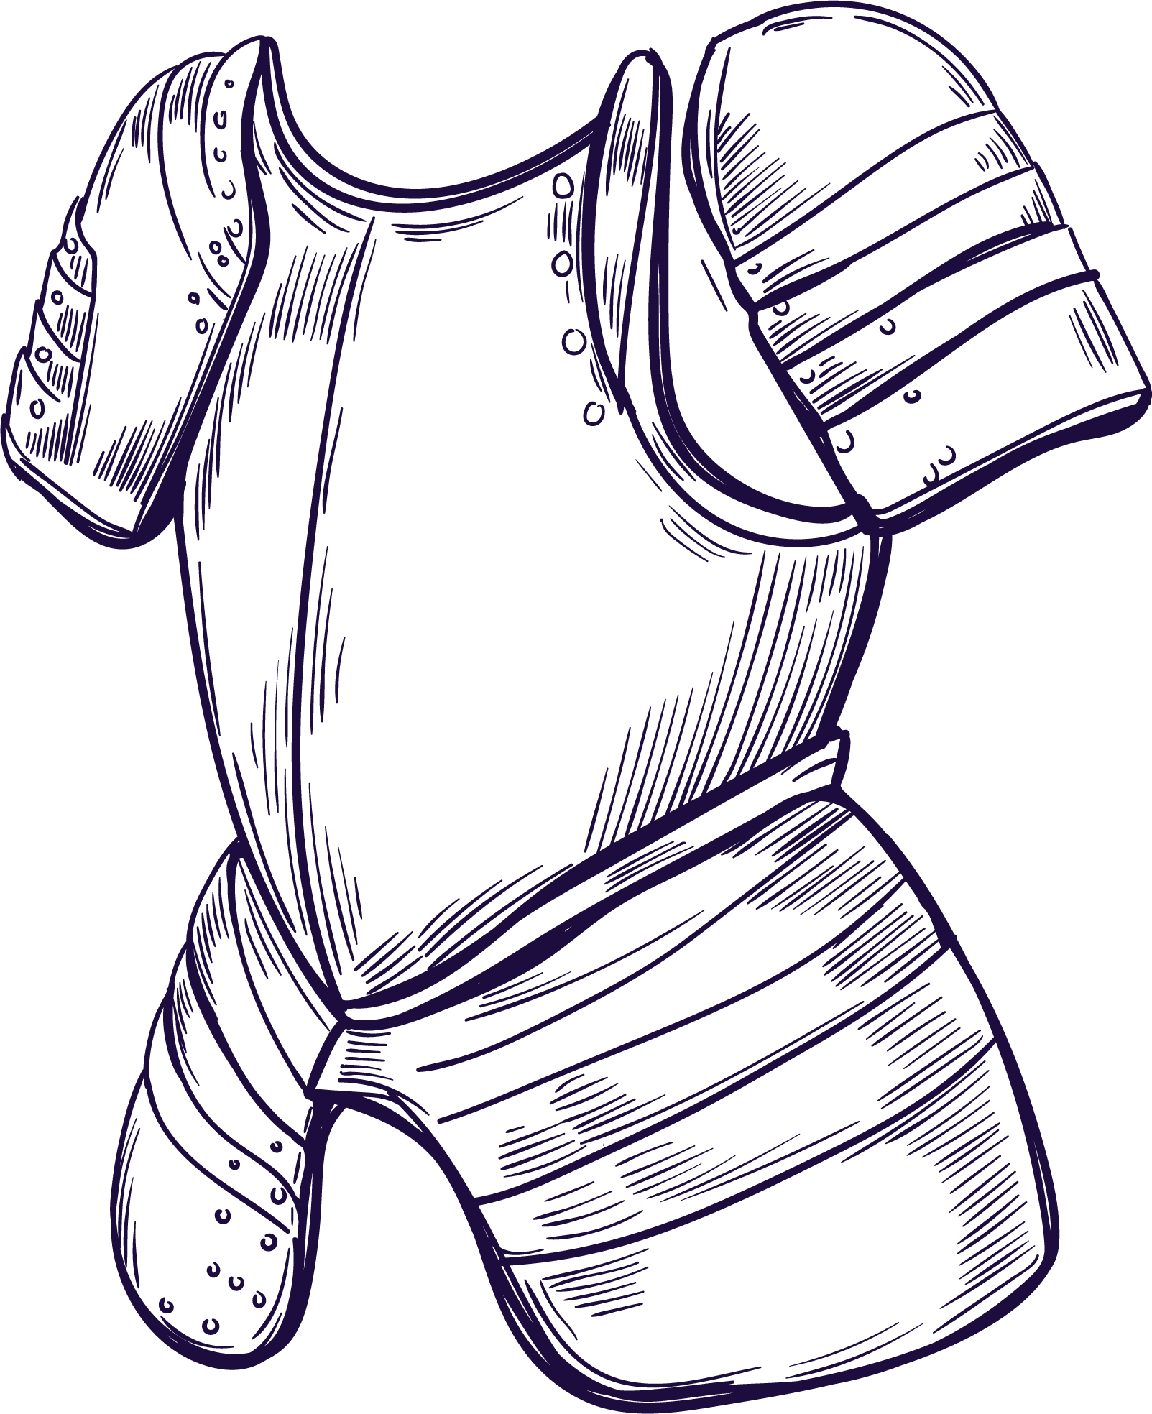
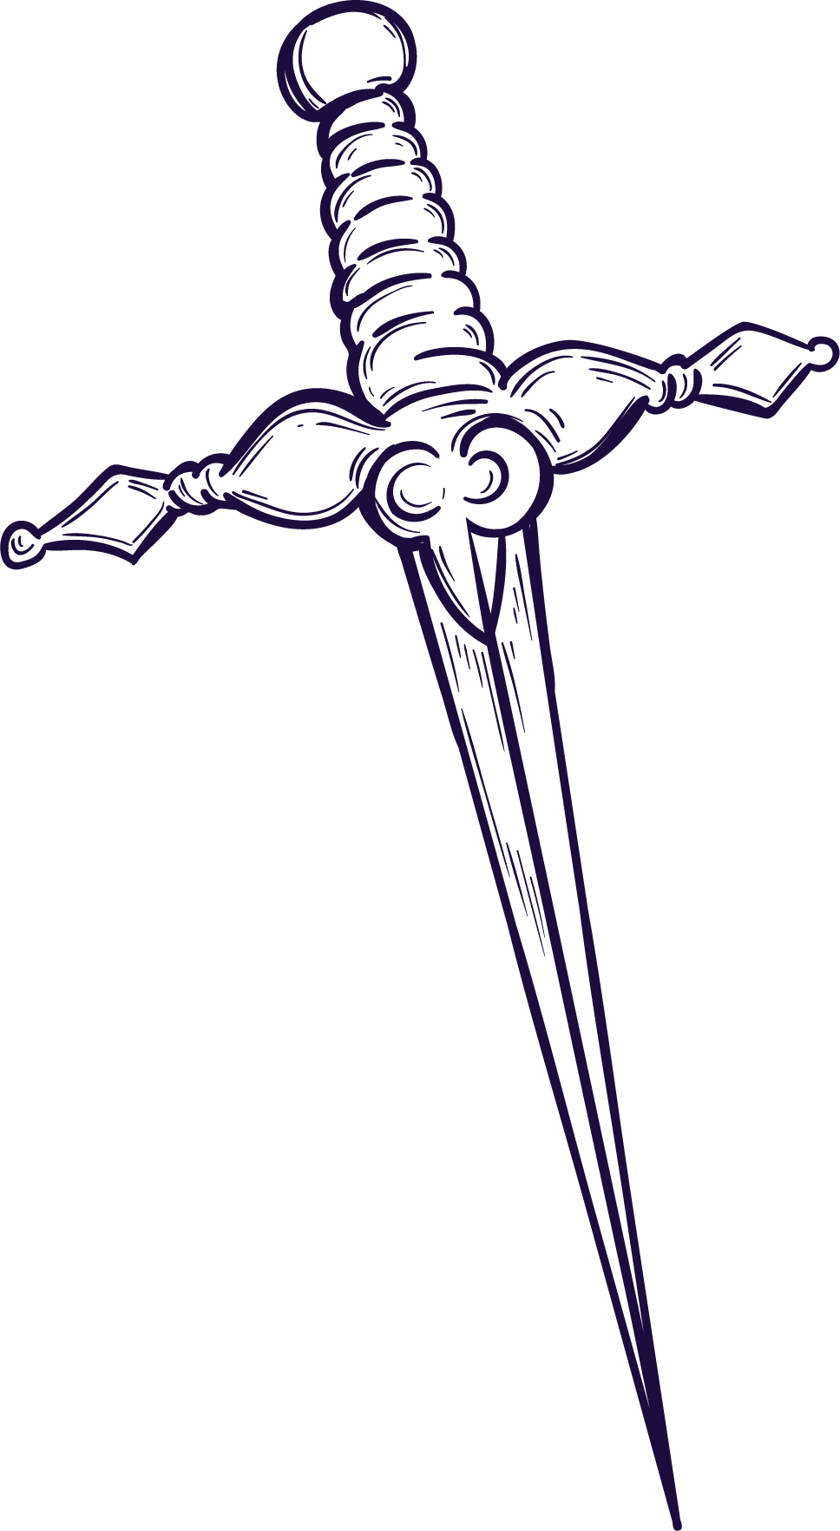
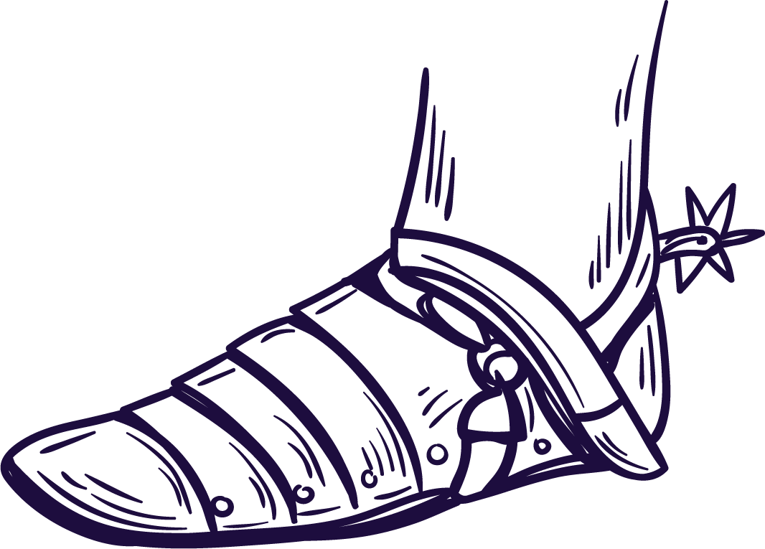
PEDIATRICS
AGE
01
INTERVENTIONS
03
SPECIAL TESTING
TYPES OF TESTS
02
04
0-18 years old
Newborn Hearing Screenings at birth
Screenings at school
Full Audiologic Evaluations to assess auditory function
FM Systems
Hearing Aids
Cochlear Implants
Bone Anchored HAs
Auditory Processing Evaluations - used for patients with normal hearing, but difficulty understanding
Vestibular/Balance - rotary chair
aABR
ABR
OAEs
CAE - can use BOA or CPA
Tympanometry

Slide 16
Types of Tests for
Pediatric Population
Automatic Auditory Brainstem Response (aABR)
ABR
OAEs
Tympanometry
Behavioral Observation Audiometry
Conditioned Play Audiometry
Performed at some hospitals during NBHS, this assesses the auditory system from outer ear to brainstem
Performed at hospital or clinical setting, ABR is an objective measure of hearing thresholds. Can be done in natural sleep or sedated.
Objective measurement of cochlear outer hair cell function
Used to assess the integrity of the middle ear system. This can show if there is something obstructing sound from traveling through the ear (e.g. wax, debris, an object), if there is negative pressure (feels like clogged ears) due to a poorly functioning Eustachian Tube, if there is a hole in the eardrum (sometimes a pinhole cannot be seen via otoscopy), or if there is fluid behind the eardrum.
Generally for younger children or cognitively impaired - look for changes to behavior when a sound is presented (e.g. eyes widening, cessation of suckling if nursing, startle response, etc.)
For older children - using blocks or some other game, condition the child to perform a task every time a sound is heard
Notes:
Sometimes tympanometry is all you can get on a child! OAEs and ABR require a quiet environment and CAEs require attention. Tympanometry can give you important information that can influence your recommendations for further testing.

Slide 17
ADULTS / GERIATRICS
AGE
01
INTERVENTIONS
03
TYPES OF TESTS
02
SPECIAL TESTS
04
>18 years old
Many adults are referred to Audiologist after failing a routine screening at PCP
Counseling - informational + Adjustment counseling
Hearing Aids
Cochlear Implants
Bone Anchored HAs
Full CAE
ABR - site of lesion
OAEs - helpful with ototoxic monitoring
Tympanometry
Vestibular - videonystagmography (VNG) / Rotary Chair
APD
Tinnitus Assessment and Management

Slide 18
THE FUTURE OF AUDIOLOGY
01
02
03
GROWTH OF THE
AGING
POPULATION
OTC DEVICES
ARTIFICIAL
INTELLIGENCE
Recent legislation has sought to make more affordable hearing solutions for patients with mild to moderate hearing loss.
Hearing aid manufacturers are expanding technology to include Artificial Intelligence!
>65 expected to double between now and 2050
>85 expected to triple in same amount of time
(Souza, 2014)
Notes:
**What’s most important about growth of the aging population?? They are staying active longer and want to remain independent. Decreases in hearing can lead to social isolation, which is the exact opposite of how they want to continue their lives.

Slide 19
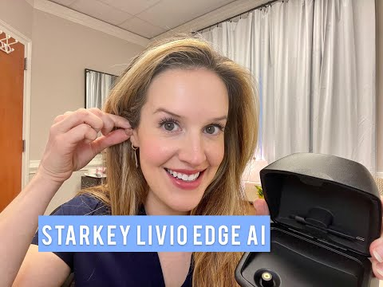
AI in Starkey

Slide 20
This Semester
Amplification
Vestibular
Tinnitus
APD
Ear Pathologies
Subjective Hearing Assessments
Weeks 2-3
Weeks 9-11
Review
Weeks 4-7
Continue Subjective Hearing Assessments + Objective Measures
Weeks 12-13
A&P of the Ear
Acoustics of Sound

Slide 21
References
American Speech‑Language‑Hearing Association. (2018). Scope of practice in audiology [Scope of Practice]. Available from www.asha.org/policy/
American Speech‑Language‑Hearing Association. (2021a). Definition of communication and appropriate targets]. Available from https://www.asha.org/njc/definition-of-communication-and-appropriate-targets/
American Speech‑Language‑Hearing Association. (2021b). Social communication. Available from https://www.asha.org/public/speech/development/social-communication/
Jerger, J. (2019). Ten highlights from the history of audiology. Available from: https://www.hearingreview.com/practice-building/practice-management/continuing-education/ten-highlights-history-audiology#:~:text=The%20modern%20era%20of%20audiology,the%20family%20of%20healthcare%20professions.
Levine Hearing. (2021). Starkey Livio Edge AI Features. YouTube. Retrieved August 11, 2021 from https://www.youtube.com/watch?v=75jRm-phPoY&t=1s
Montana State Fund. (2018). Ear protection. YouTube. Retrieved August 11, 2021 from https://www.youtube.com/watch?v=GrC5-s4CI64

