Slide 1
SPEC 2481: Class #2 Anatomy/Physiology Review

Slide 2
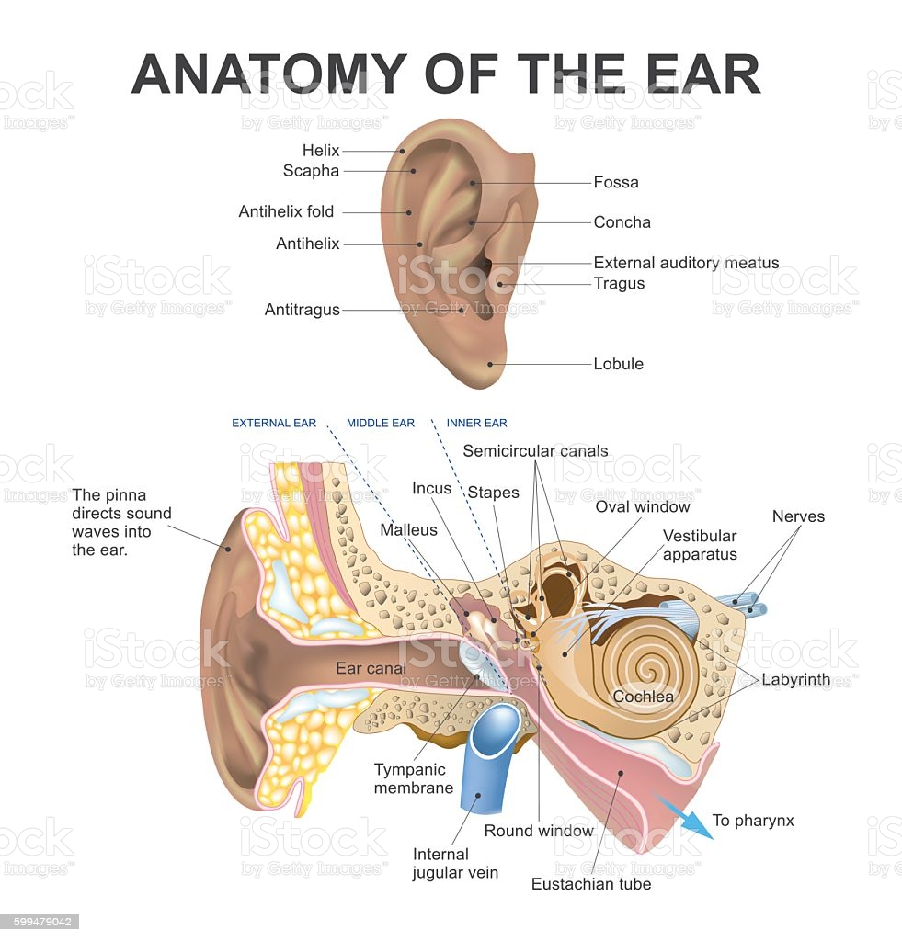
Anatomy of the Ear
3 main parts make up the anatomy of the ear:
Outer ear - external/visible part of the ear (pinna) and the ear canal
Middle ear - tympanic membrane (eardrum) and the ossicles (bones of the ME), the stapes, malleus, and incus.
Inner ear - the perilymph filled cochlea / hearing organ which houses the endolymph filled membranous labyrinth.
Notes:
https://www.istockphoto.com/vector/anatomy-of-the-ear-gm599479042-102900869

Slide 3
video
Anatomy of the Ear
Notes:
https://www.youtube.com/embed/qYv9V2qna6I

Slide 4
Outer Ear - Anatomy
Important landmarks to remember:
Pinna/Auricle - captures sound and funnels it into the external auditory meatus (ear canal)
Concha - bowl shaped portion of OE that leads into the ear canal - important for taking earmold impressions for custom hearing aids

Slide 5
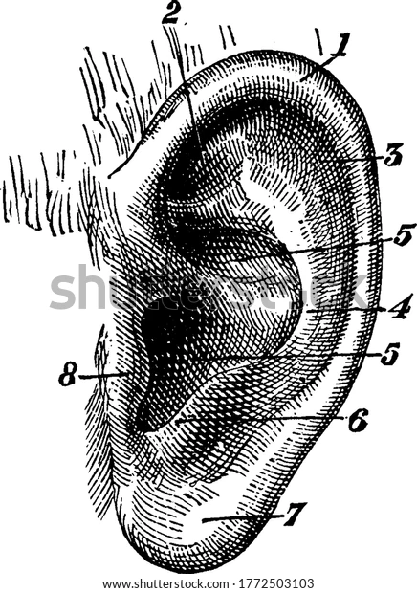
Outer Ear
Helix - outer rim of the ear
Triangular fossa - small triangular shaped indentation at the medial/superior portion of the outer ear
-
Anti-helix - inner rim
5. Concha - bowl of
outer ear that
leads into the ear
canal (external
auditory meatus)
6. Anti-tragus -
opposite the
tragus
7. Lobule
8. Tragus

Slide 6
Outer Ear - Physiology
Functions of the OE
Protection of the middle and inner ear structures
Sound Collector - more efficient at delivering high frequencies where consonant speech sounds are → give us clarity in speech understanding
Localization - two ears together help us know where a sound is coming from

Slide 7
Outer Ear - Physiology
The pinna acts as a sound collector for higher frequencies. Lower frequencies, with large wavelengths, pass around the pinna.
The asymmetrical, irregular shape of the pinna provides horizontal localization cues (front, back, side) better than vertical localization cues (up and down)

Slide 8
Outer Ear - Physiology
The external auditory meatus acts as a ¼ wavelength resonator, or a tube that is open at one end closed at the other.
The EAM resonates around 2-5000Hz, meaning it amplifies and enhances sounds best at these frequencies.
It is not a hard-walled cavity, giving it a broad frequency response.
Outer ⅓ is cartilaginous
Inner ⅔ is osseous (bony)

Slide 9
Outer Ear - Physiology
The sebaceous glands produce cerumen [ear wax].
Purpose
Protects the ear from debris and insects
Foreign Bodies
Notes:
https://med.uth.edu/orl/online-ear-disease-photo-book/chapter-14-foreign-body/foreign-body-images/

Slide 10
Middle Ear - Anatomy
Tympanic membrane (ear drum)
Pars flaccida - superior 1/9 - thinner than rest of TM
Pars tensa - remaining 8/9 of TM
Umbo - most depressed point
Ossicles - bones of the middle ear
Malleus - “hammer” - connects to TM
Incus - “anvil”
Stapes - “stirrup” - footplate connects to oval window of cochlea
Eustachian Tube - equalizes air pressure in ME
Stapedius and tensor tympani muscles

Slide 11
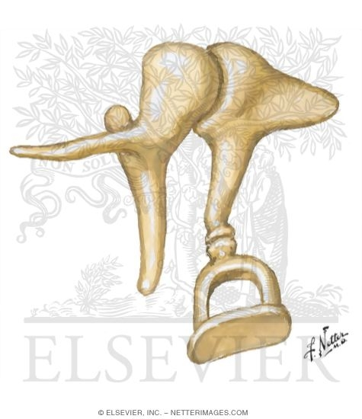
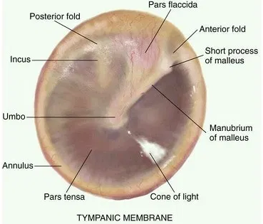
Middle Ear - Anatomy
Notes:
https://medicoapps.org/m-tympanic-membrane-of-ear-eardrum/

Slide 12
Middle Ear - Physiology
Sound travels from OE to vibrate the tympanic membrane
Most sensitive to frequencies 1000-5000Hz
Manubrium of malleus, connected to the TM, moves ossicular chain -- ending with the stapes footplate in the oval window of the cochlea

Slide 13
Impedance
Sounds impinging on the OE are airborne (low impedance), but the environment in the IE is aqueous (high impedance). Normally when sound travels from air-->water, 99.9% of the acoustical energy is reflected.
How do we overcome this impedance mismatch??
Impedance Mismatch
Notes:
https://www.ncbi.nlm.nih.gov/books/NBK11076/#:~:text=The%20major%20function%20of%20the,a%20medium's%20resistance%20to%20movement.&text=Two%20mechanical%20processes%20occur%20within,achieve%20this%20large%20pressure%20gain.
Think of swimming under water and someone speaks to you from outside the pool, can you hear what they are saying?

Slide 14
Middle Ear - Physiology
The mismatch between air and cochlear fluids is ~30dB
How the middle ear system overcomes the impedance mismatch
Middle ear transformer - intensity will be greater when force increases or density decreases - the TM is 17x bigger than the stapes footplate → leads to 25dB gain
Ossicular Lever Ratio - manubrium of malleus > long process of the incus - the difference in length is a lever which increases force at the TM → a ratio of 1.3
Curved membrane ratio - increases force by 2x
17 x 1.3 x 2 = 40x → ~32dB gain

Slide 15
Inner Ear - Anatomy
Cochlea - hearing organ which houses many important structures
Scala vestibuli, scala tympani, scala media
Basilar membrane
Organ of Corti
Semicircular canals - superior, posterior, lateral
Saccule
Utricle

Slide 16
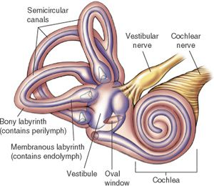
Cochlea - Anatomy of the Inner Ear
Cochlea - snail-shell shaped organ of hearing
Semi-circular canals - fluid filled organs of balance
Superior
Posterior
Lateral
Vestibulocochlear nerve (VIII)
Sends electrical impulses to the brain for hearing (cochlear nerve) and balance (vestibular nerve)
Notes:
https://www.britannica.com/science/basilar-membrane

Slide 17
Inner Ear - Physiology
Vibrations from the ossicles of the middle ear move the stapes footplate in the oval window of the cochlea
These vibrations move the fluid of the IE (perilymph & endolymph) along the basilar membrane
Displacement of the basilar membrane causes movements of the hair cells, which are in contact with the tectorial membrane
The shearing action of the outer hair cells at the tectorial membrane sends electrical impulses to the brain to decode the sounds into messages.
The brain uses familiar sounds to decode the messages

Slide 18
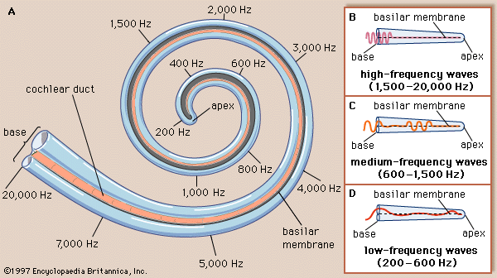
Basilar Membrane - Physiology in the Inner Ear
Base to apex
High freq to Low freq - tonotopically organized
As the wave travels down the basilar membrane, it will have maximum displacement at its center frequency
Perilymph in scala vestibuli and scala tympani
Endolymph in scala media
Stapes footplate at oval window sends vibrations in perilymph of scala vestibuli
Notes:
https://www.britannica.com/science/basilar-membrane

Slide 19
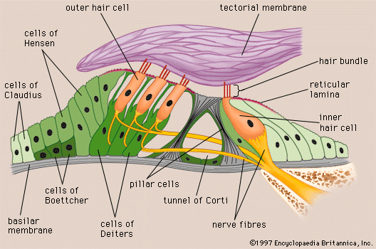
Organ of Corti - Physiology in the Inner Ear
Houses the hair cells - stereocilia atop the hair cells give them this name
Outer hair cells (OHC) - 3 rows of ~13,500 OHC
Inner hair cells (IHC) - 1 row of 3,500 IHC
The rows of HCs sit on the basilar membrane
As the BM vibrates from an incoming signal, it moves the Organ of Corti → the HCs → which move the tectorial membrane (TOP)
This will convert the acoustic information into electrical impulses up to the brain for processing
Notes:
https://www.britannica.com/science/ear/Organ-of-Corti

Slide 20
Now that we’ve seen the anatomy & physiology of the ear - let’s put it together
How Sound Travels

Slide 21
Sound traveling through the ear
Pinna collects the sounds
™ vibrates in response to incoming sounds
Malleus begins vibration of the entire ossicular chain ending at the stapes
Displacement of perilymph moves the basilar membrane
The Organ of Corti moves in response to the BM.
Signals from the hair cells will create electrical impulses along the VIIth nerve as it travels up to the brain
OE
EAM
TM
TM
ME Bones
Foot
plate
IE Fluid
BM
Corti
HCs
VIIIth nerve
Brain
The stapes footplate is embedded in the oval window of the cochlea, which causes displacement of the perilymph in the scala media
Sound travels down the EAM or ear canal to the TM
Vibration of ™ will begin movement of ossicles - starting at malleus (connected to ™)
Maximal displacement will occur at the center frequency of the incoming sound on the basilar membrane
Hair cells in the OC that are in contact with the tectorial membrane will create a shearing action sending signals to the VIIIth nerve
The brain decodes and processes the information into speech signals
Notes:
Gelfand, Stanley. Essentials of Audiology. NEW YORK: Thieme Medical Publishers, Incorporated, 2016. Print.

Slide 22
References
Britannica, T. Editors of Encyclopaedia (2021, August 11). Basilar membrane. Encyclopedia Britannica. https://www.britannica.com/science/basilar-membrane
Britannica, T. Editors of Encyclopaedia (2021, August 11). Inner ear. Encyclopedia Britannica. https://www.britannica.com/science/inner-ear
Britannica, T. Editors of Encyclopaedia (2021, August 11). Cochlea. Encyclopedia Britannica. https://www.britannica.com/science/ear/cochlea
Gelfand, Stanley. Essentials of Audiology. NEW YORK: Thieme Medical Publishers, Incorporated, 2016. Print.
Hasudungan, A. (2015). Anatomy - Ear Overview. Retrieved August 23, 2021 from: https://www.youtube.com/watch?v=qYv9V2qna6I&t=9s
Khan Academy. (2019). Human ear - structure and working. Retrieved August 23, 2021 from: https://www.youtube.com/watch?v=98-6WfdumZY
MedicoApps. (2021). Tympanic membrane of ear. Retrieved August 23, 2021 from: https://medicoapps.org/m-tympanic-membrane-of-ear-eardrum/
Physiology Open. (2020). Impedance mismatching physiology. Retrieved August 23, 2021 from: https://www.youtube.com/watch?v=7P3T0ZZ3utA
Purves D, Augustine GJ, Fitzpatrick D, et al., editors. Neuroscience. 2nd edition. Sunderland (MA): Sinauer Associates; 2001. The Middle Ear. Available from: https://www.ncbi.nlm.nih.gov/books/NBK11076/
Shutterstock. (2021). External ear images. Retrieved August 23, 2021 from: https://www.shutterstock.com/search/external+ear
Silverman, C.A. (2016). Anatomy and Physiology [PowerPoint slides]
University of Texas - Health Science Center at Houston. (2008). Foreign body images. Retrieved August 23, 2021 from: https://med.uth.edu/orl/online-ear-disease-photo-book/chapter-14-foreign-body/foreign-body-images/

