Slide 1
Pathologies of the Ear
Types of Hearing Loss

Slide 2
Topics in this Lecture
What is an audiogram and what information do we learn from it?
Three different types of hearing loss
Most common pathologies of the outer ear
Most common pathologies of the middle ear
Most common pathologies of the inner ear

Slide 3
AUDIOGRAMS
The visual representation of a person’s hearing levels.

Slide 4
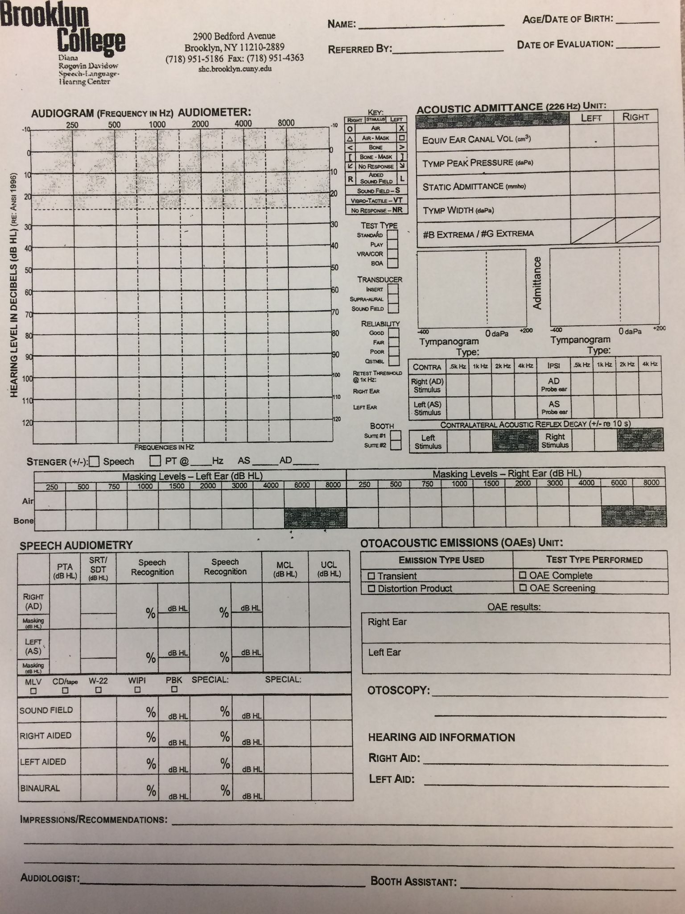
Audiogram
Notes:
Pure tones are marked here
Speech audiometry goes here
Immittance goes here
Otoacoustic emissions are recorded here

Slide 5
Audiogram Features
Pure Tones*
Speech Audiometry
Acoustic Immittance*
Otoacoustic Emissions
Gives us the threshold of hearing for a patient. Marked by Red O’s (right) and Blue X’s (left) for air conduction and carrots < > for bone conduction
Tests to assess how quietly a patient can hear and repeat 2-syllable words and how well they perform when words are at a comfortable level.
An assessment of how the eardrum is moving - which also tells us how sound is traveling through the system.
An assessment on the function of cochlear outer hair cells.
Notes:
PTs and Immittance are helpful in identifying particular pathologies, we’ll discuss these a little further today, but will go into greater detail in the upcoming weeks!

Slide 6
AIR V. BONE CONDUCTION
AIR CONDUCTION
BONE CONDUCTION
Assessing the patient’s hearing thresholds the way they hear in real life i.e. sound is presented through an earphone (over the ear or in the ear) and it travels from outer → middle → inner ear. This checks hearing levels through the entire system.
Bypasses the outer and middle ear systems and assesses hearing levels directly at the inner ear (cochlea). This is achieved with the use of a bone oscillator placed directly on the mastoid bone.

Slide 7
ACOUSTIC IMMITTANCE
A
As
Ad
“Normal”
“Stiff”
“Floppy”
B
C
“Flat”
“Retracted”
Normal ear canal volume
Normal movement of the eardrum with relatively equal pressure on both sides
Normal ECV
Relatively equal pressure
Little movement of the eardrum
Normal ECV
Relatively equal pressure
Excessive movement of the eardrum
No peak = no movement of the eardrum
ECV can be very small, normal, or very large
Negative pressure pulls the eardrum inward toward the nose

Slide 8
Types of HL
Conductive
Sensorineural
Mixed

Slide 9
Conductive HL
Damage to the auditory system that occurs before the cochlea and VIIIth nerve. This can be a blockage from the outer ear (wax, stenosis, atresia) or a problem with the middle ear (fluid, broken ossicles, hole in the TM). Many CHL cases are reversible once the blockage has been resolved. On the audiogram you will see bone conduction levels that are better than air conduction levels, because the blockage or damage has been bypassed.

Slide 10
Try This!
It’s easy to simulate a conductive hearing loss at home. You can plug your ears by either holding down the tragus to cover the opening to your ear canal, or if you have ear plugs handy - roll them up tight, insert them into your ear canal and wait for everything to get quieter!

Slide 11
OE/ME Pathologies that can cause CHL
01
02
03
CERUMEN
TM PERFORATION
ME EFFUSION
04
05
06
ATRESIA/MICROTIA
OSSICULAR DISCONTINUITY
OTOSCLEROSIS
A buildup of wax in the outer ear causes a temporary high frequency loss
A hole in the ear drum that causes hearing loss to an inadequate movement of sound through the system
Commonly called an ear infection, this is fluid in the ME space due to an ineffective Eustachian Tube
Either no Outer Ear or a poorly formed OE - can be pinna or ear canal
When the ME bones become disconnected from each other
Stiffening/calcification of the stapes footplate in the oval window which causes inadequate movement for vibration

Slide 12
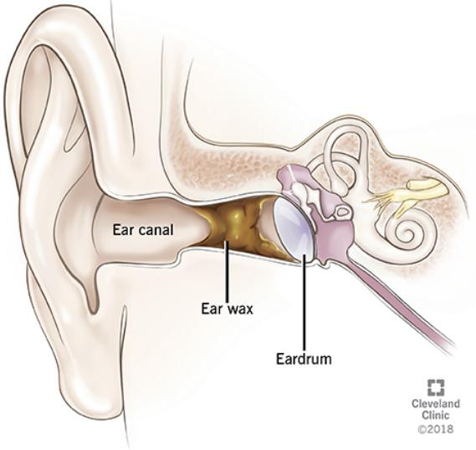
01
CERUMEN IMPACTION
HF CHL
Usually normal hearing except a precipitous drop at 8kHz - Type B tympanogram with small ECV
Can be caused by use of Q-tips!

Slide 13
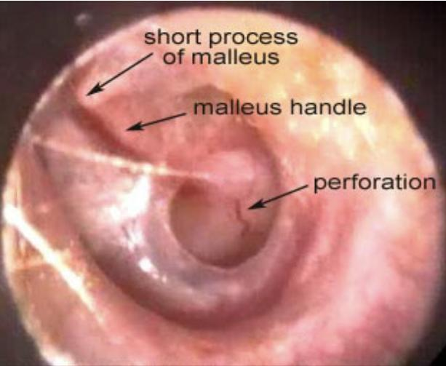
02
PERFORATION
Can be caused by trauma (pressure, object) or by medical necessity
Causes a CHL due to lack of vibration of the eardrum - the size and location of the perforation dictates the HL
Type B tympanogram with large ECV
Types of TM Perforations

Slide 14
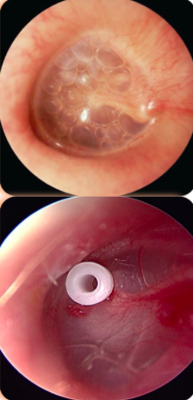
03
OTITIS MEDIA W/ EFFUSION
Fluid present behind the eardrum - caused by malfunction in the ET
Most commonly referred to as an ear infection
Causes a flat, moderate CHL with Type B tympanogram
Resolved by medication
Recurrent OME may require surgery (PE Tubes)

Slide 15
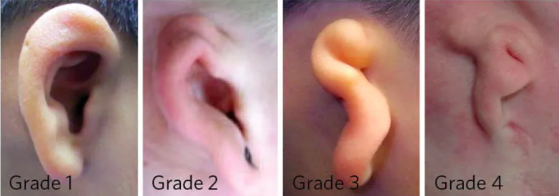
04
ATRESIA / MICROTIA
Atresia - absence or abnormal narrowing of the ear canal
Microtia - absence or abnormal structure of the pinna
The greater the malformation, the greater the CHL
Vanderbilt, 2020
Notes:
Grade 1: Smaller than normal, but the ear has mostly normal anatomy.
Grade 2 – Part of the ear looks normal, usually the lower half. The canal may be normal, small or completely closed.
Grade 3 – Just a small remnant of “peanut-shaped” skin and cartilage. There is no canal, which is called aural atresia.
Grade 4 – Complete absence of both the external ear and the ear canal, also called “anotia.”

Slide 16
05
OSSICULAR DISCONTINUITY
Can be caused by trauma to the ear (e.g. car accident)
A break in the ossicular chain - most commonly at the joint between the incus and the stapes.
Causes a maximal CHL of 50-60dB HL.
Type Ad tympanogram
Notes:
Causes: An indirect blow to the contralateral side, Blast injuries, Direct traumatization via instrumentation of the external auditory canal, Barotrauma
The most common mechanisms of injury are road traffic collisions (RTC), falls, and interpersonal violence
Campbell and Tan 2020

Slide 17
06
OTOSCLEROSIS
Stiffening of the stapes footplate in the oval window
Most common in pregnant and menopausal women
Causes a CHL due to the lack of movement of the stapes in the OW - precludes the fluid in the IE from being displaced
Type As tympanogram
Carhart’s Notch (BC > at 2kHz)

Slide 18
Sensorineural HL
Damage to the auditory system that occurs after the Middle Ear. This is generally a permanent hearing loss that will not improve, but may get worse. The damage in the cochlea affects the hair cells, where they no longer react to movement of the basilar membrane and consequently are unable to stimulate the tectorial membrane to enact nerve impulses to the brain.

Slide 19
Causes of SNHL
Congenital
Noise Exposure
Aging
Illness

Slide 20
IE Pathologies that can cause SNHL
01
02
MENIERE’S DISEASE
ACOUSTIC NEUROMA
03
04
05
NOISE EXPOSURE
PRESBYCUSIS
OTOTOXICITY
Overproduction of endolymph that leaks into the ME space
A benign tumor on the VIIIth nerve. Causes a SNHL in the ear with the tumor.
Can be occupational or recreational exposure to loud sounds for an extended period of time leading to hearing loss and tinnitus
An aging auditory system is affected first in the higher frequencies -- the ones closest to the base of the basilar membrane.
Medications that have adverse effects on the auditory system.

Slide 21
01
MENIERE’S DISEASE
Caused by overproduction of endolymph in the scala media- AKA endolymphatic hydrops
Symptoms include - fluctuating hearing loss, “roaring” LF tinnitus, episodic vertigo (room spinning), aural fullness
Can be managed by diet to prevent outbreaks
Notes:
Rose, S. (2020). Hearing Speech with a Reverse Slope Hearing Loss. Retrieved from:
https://www.youtube.com/watch?v=ewOpW-4XFqM
:50 - 3:20

Slide 22
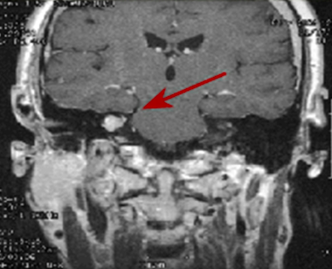
02
ACOUSTIC NEUROMA
Benign tumor on VIIIth nerve
Usually unilateral
Symptoms include: unilateral tinnitus, HL, possible dizziness
VERY poor speech understanding in the affected ear
Surgery to remove the tumor may result in complete loss of hearing

Slide 23
IMPORTANT
An acoustic neuroma (a.k.a. Vestibular schwannoma) is seen on the audiogram as a sensorineural hearing loss. However, it is technically classified as a retrocochlear pathology.

Slide 24
RETROCOCHLEAR PATHOLOGY
Literally meaning behind the cochlea, these pathologies are ones that do not occur in the inner ear, but rather in the VIIIth nerve or even further up the chain (e.g. brainstem).
Some signs of retrocochlear pathology:
Unilateral tinnitus
Asymmetrical hearing loss
Asymmetrical speech scores

Slide 25
03
NOISE EXPOSURE
Can be repeated exposures over many years (e.g. work-related) or a single, very loud exposure (e.g. blast injury)
Audiogram will show a noise notch at 4kHz (can also be a 3 or 6kHz) → nerve fibers at basal end of BM are affected first.
Temporary vs. permanent threshold shift
Notes:
TTS= temporary threshold shift
Threshold recover after exposure is over
Usually lasts for a few days
PTS= Permanent threshold shift
Threshold loss is irreversible after repeated exposures

Slide 26
04
PRESBYCUSIS
Also called age-related hearing loss
A gradual decrease in hearing due to aging, will present as a HF SNHL on the audiogram
Cochlear hair cells begin to degenerate
Less blood supply to Organ of Corti
Notes:
Rose, S. (2020). Hearing speech with a sloping hearing loss. Retrieved from: https://www.youtube.com/watch?v=G8lVEsoozAs :55 - 5:30

Slide 27
05
OTOTOXICITY
Caused by exposure to medication - can cause HL or ringing in the ears
Aminoglycosides - used for bacterial infections. End in -mycin (gentamycin, kanamycin)
Chemotherapy agents (cisplatin)
Quinines - used to treat malaria
Salicylates - aspirin

Slide 28
Mixed HL
A hearing loss that presents with both a sensorineural and conductive component. This can be that a patient is exposed to loud noises or suffers from presbycusis (both SNHL) and also has fluid in the middle ear space (CHL). Some hereditary hearing losses present with MHL as well.

Slide 29
GENETIC TRANSMISSION OF HL
Genetic transmission can be any presentation of HL (CHL, SNHL, MHL)
It can be present at birth or can be a late-onset HL
Can be classified as syndromic or non-syndromic
Syndromic HL - occurs with other medical and physical disorders
Non-syndromic HL - mutation in a single gene without other symptoms - an isolated finding

Slide 30
Risk Factors for HL in Infants
Infants with any of these risk factors are 10x more likely to have HL than their peers (Allen & Goldman, 2020).
Low birth weight | Hyperbilirubinemia | Family History of HL
Craniofacial Abnormalities | Bacterial Meningitis | Low APGAR score
 | TORCH infections
Notes:
TORCH - toxoplasmosis, other viral infections, rubella, cytomegalovirus, herpes

Slide 31
Syndromic HL (~20% of cases)
USHER SYNDROME
PENDRED SYNDROME
WAARDENBURG SYNDROME
TREACHER COLLINS
BRANCHIO-OTO-RENAL (BOR)
OSTEOGENESIS IMPERFECTA
Severe vision impairment
Variable HL (profound, moderate, progressive) _ balance dysfunction
Goiter (in the neck)
HF HL
Enlarged vestibular aqueduct
White forelock
Ice blue eyes
Flattened bridge of nose
SNHL
Facial malformations (cleft palate, downward slanting eyes, malformed outer ear)
CHL or SNHL + vestibular dysfunction
Ear pits/tags, branchial cleft sinuses, and renal (kidney) involvement.
Significant HL - CHL, SNHL, MHL
Fragile bones, blue sclera, and hyperelastic joints and ligaments
CHL, SNHL, MHL
Notes:
Allen SB, Goldman J. Syndromic Sensorineural Hearing Loss. [Updated 2020 Aug 24]. In: StatPearls [Internet]. Treasure Island (FL): StatPearls Publishing; 2021 Jan-. Available from: https://www.ncbi.nlm.nih.gov/books/NBK526088/

Slide 32
Non-Syndromic HL
Gap junctions in cell membranes allow ions and other small molecules to pass through into the cell
Composed of connexin proteins
Connexin 26 forms gap junctions between supporting cells and underlying hair cells in the cochlea
Recycle potassium ions through Organ of Corti
The most common single gene mutation occurs at GJB2 (gap junction beta 2) gene codes for the protein Connexin 26

Slide 33
References
Allen SB, Goldman J. Syndromic Sensorineural Hearing Loss. [Updated 2020 Aug 24]. In: StatPearls [Internet]. Treasure Island (FL): StatPearls Publishing; 2021 Jan-. Available from: https://www.ncbi.nlm.nih.gov/books/NBK526088/
Campbell E, Tan NC. Ossicular-Chain Dislocation. [Updated 2021 Aug 4]. In: StatPearls [Internet]. Treasure Island (FL): StatPearls Publishing; 2021 Jan-. Available from: https://www.ncbi.nlm.nih.gov/books/NBK560621/
Cleveland Clinic. (2018). Earwax buildup and blockage. Retrieved from: https://my.clevelandclinic.org/health/diseases/14428-ear-wax-buildup--blockage
Ozturk, O. (2020). Fluid accumulation in the middle ear. Retrieved from: https://drozcanozturk.com/en/fluid-accumulation-in-the-middle-ear-otitis-media-with-effusion-and-tube-insertion-in-the-eardrum/
Rose, S. (2020). Hearing Speech with a Reverse Slope Hearing Loss. Retrieved from: https://www.youtube.com/watch?v=ewOpW-4XFqM
Rose, S. (2020). Hearing speech with a sloping hearing loss. Retrieved from: https://www.youtube.com/watch?v=G8lVEsoozAs
University of Nebraska Medical Center. (2014). Tympanic membrane perforations. Retrieved from: https://app1.unmc.edu/medicine/heywood/otology/unit5-tympanic-membrane-perforations.cfm
Vanderbilt University Medical Center. (2021). What are microtia and atresia? Retrieved from: https://microtiaandatresiacare.com/microtia-and-atresia/

